Slide 1


API Dataset Research
Lauralee Callahan Nick Daugherty Prakash Maddirala Cade Deal

Slide 2
Research Purpose
For this research project, we explored the Spotify API to analyze extensive music data in a compelling and accessible way. Utilizing this API allowed us to investigate trends within popular music over recent decades, deepening our understanding of evolving musical preferences and sharpening our skills in effectively querying Spotify's robust dataset, which we then leveraged to populate a SQL database using SQLAlchemy.

Slide 3
Main Objectives
1. Genre Popularity Over Time
Identifying patterns and trends in music over time by analyzing datasets that include information on genres, artists, and songs. This will help us understand how music styles and preferences have evolved
2. Artist Popularity Over Time
Examining datasets that include listener demographics, behavior, and feedback, we can gain insights into what makes certain music more appealing to different audience segments.
3. Correlation Between Song length and popularity
Studying how song length correlates with overall popularity can help artists tailor their work to better engage audiences and drive industry innovation. It also hints at the attention span of our large source playlist’s listeners.
4. Do Popular Artists Make Popular Songs, or Do Popular Songs Make Artists Popular?
This study explores whether an artist's fame influences song success or vice versa, using historical data to understand celebrity dynamics in the music industry and identify factors driving long-term artist success.

Slide 4
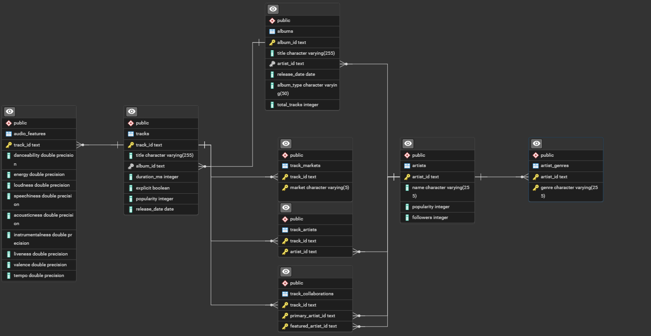
ERD

Slide 5
How is Popularity Measured?
Spotify calculates the popularity score for each track and artist using several factors, including:
Streaming data
User interaction
Recency of plays
Overall listening trends within Spotify’s user base.
The popularity score ranges from 0 to 100, where:
100 indicates the track is extremely popular on the platform.
0 means it's not well known or very obscure.

Slide 6
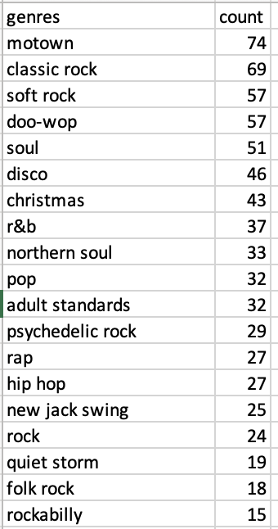
1. Genre Popularity Over Time
The most popular genre from 1958 to 2024
Motown

Slide 7
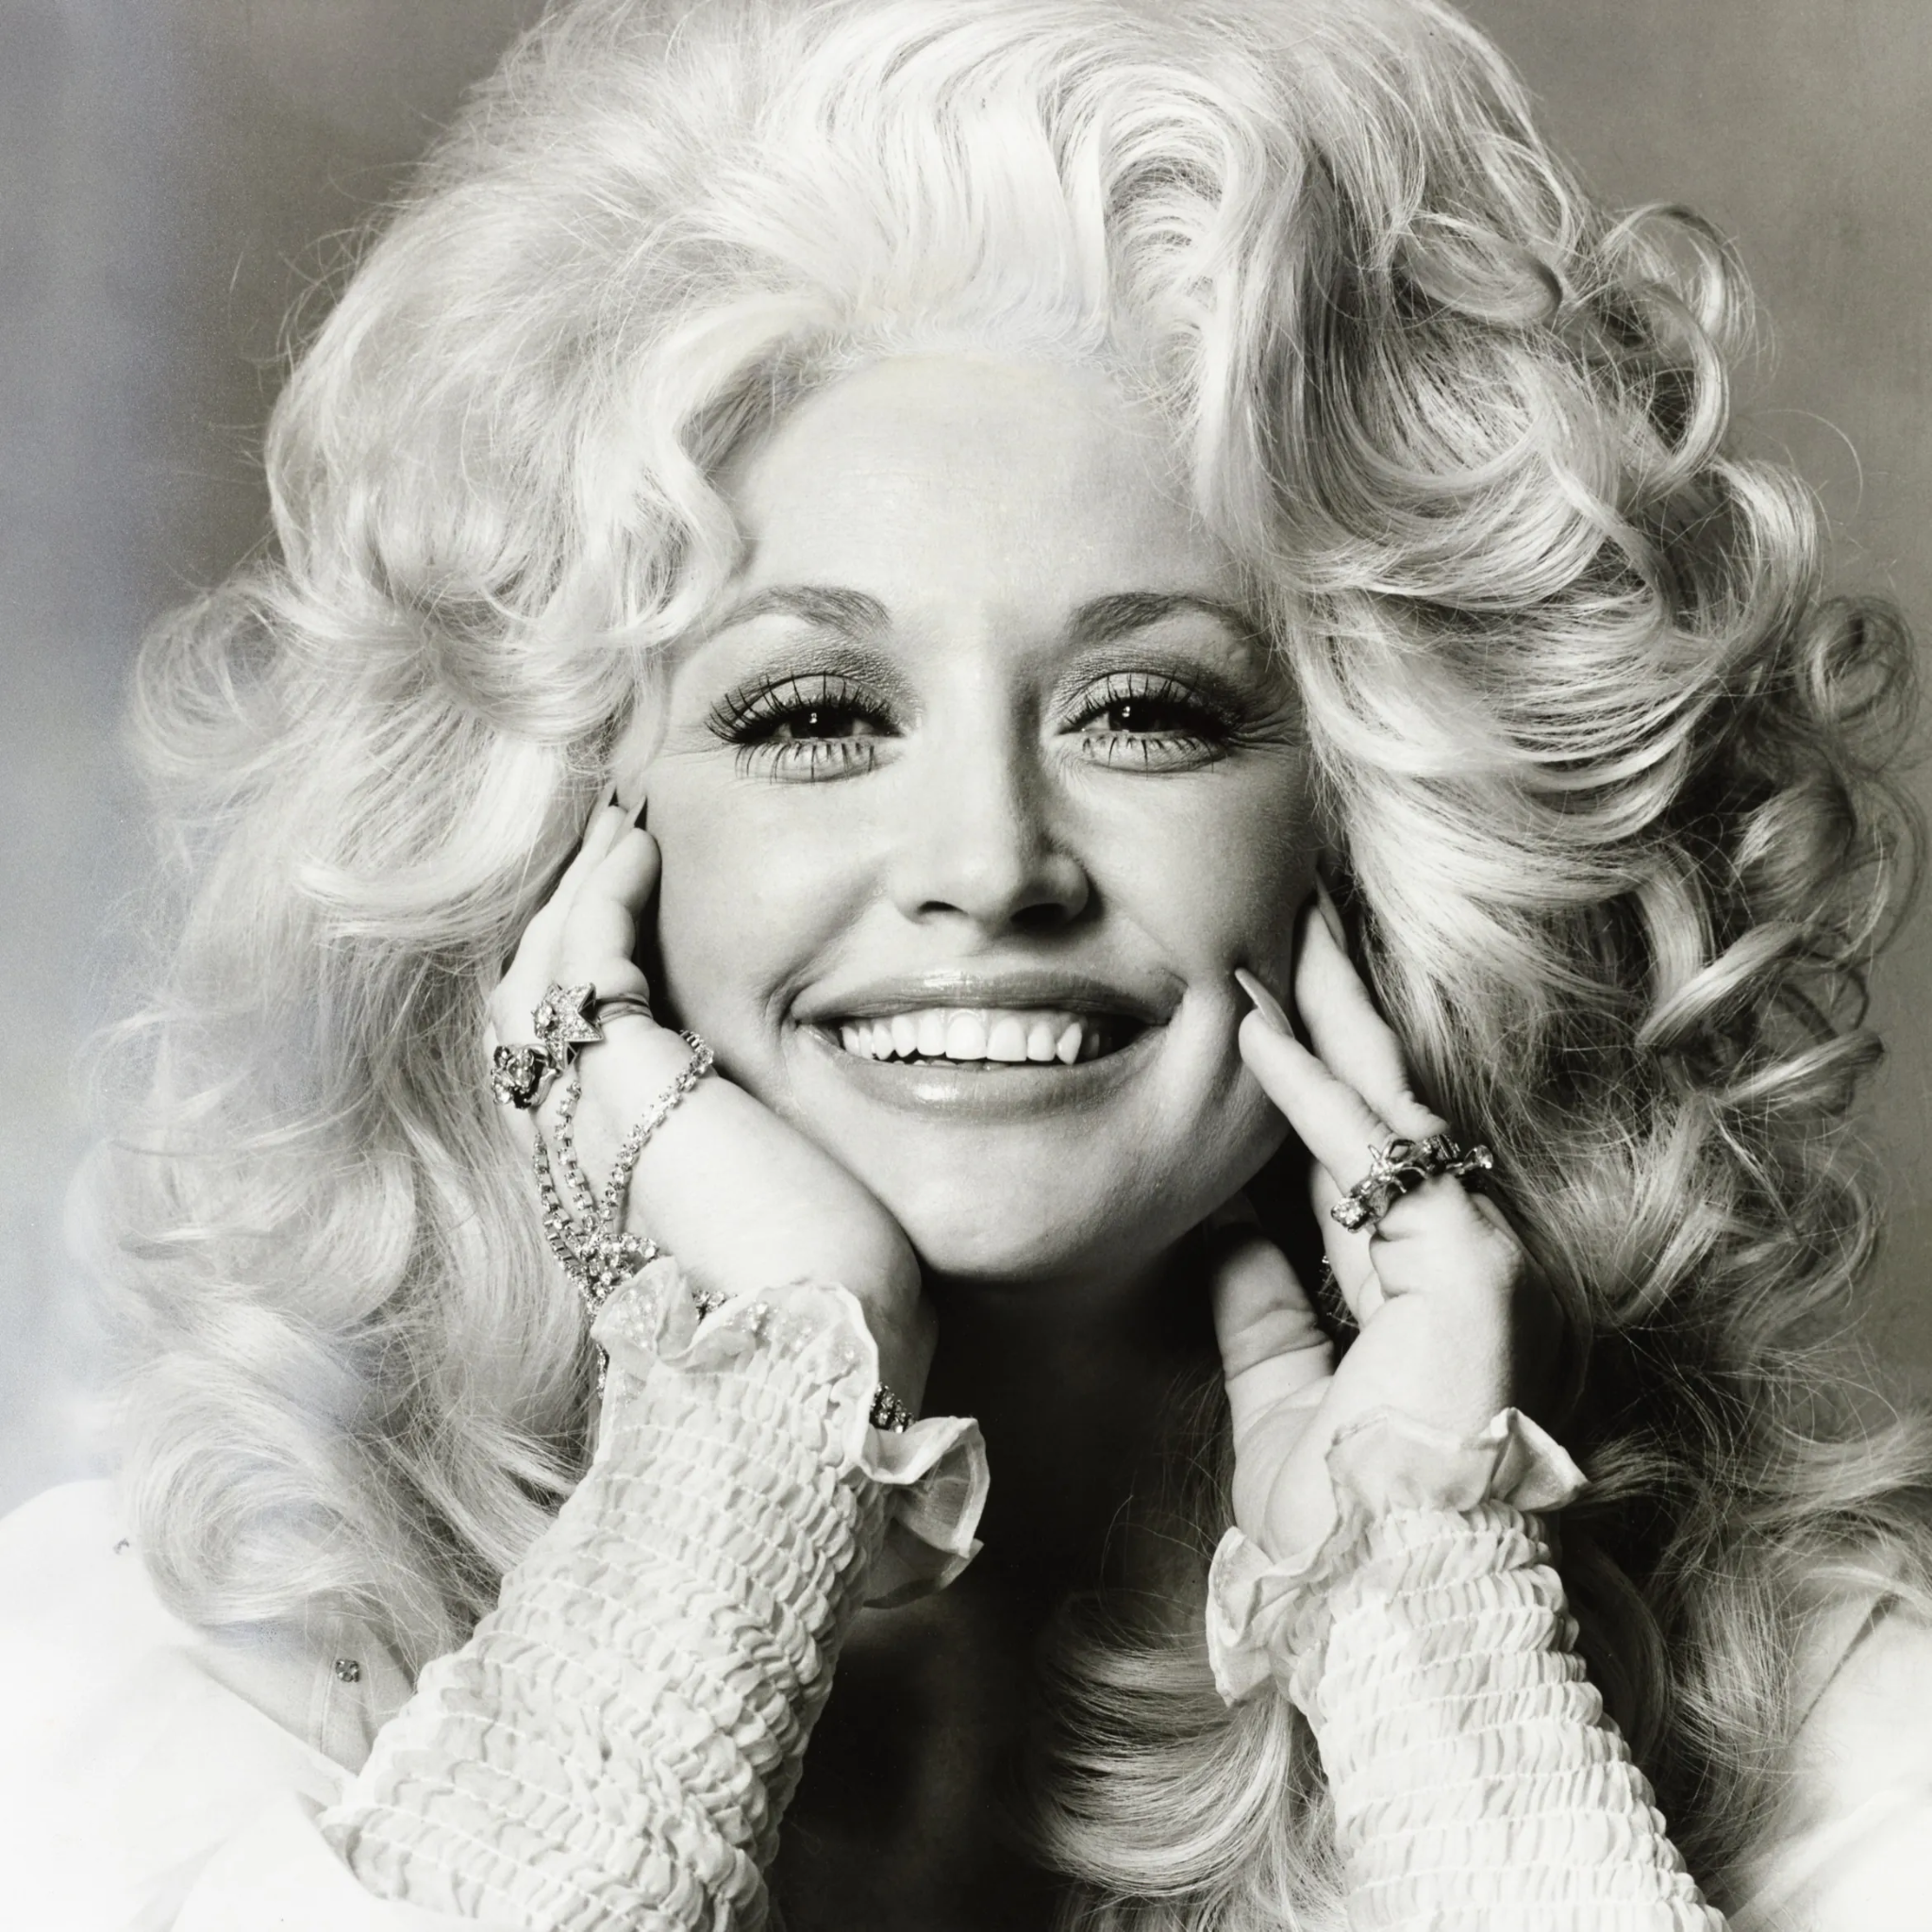
2. Artist Popularity Over Time
9 to 5 is the most popular album with a popularity
score of 77
1977 was the year she was most popular
As she produced two albums in this year
The 2020s have shown to be the most popular decade for her music

Slide 8
2. Artist Popularity Over Time
Top 5 Artists Globally Compared to Dolly Parton
Artist: Dolly Parton, Popularity: 74
Artist: *NSYNC, Popularity: 72
Artist: *67, Popularity: 45
Artist: Eric Carmen, Popularity: 65
Artist: Clifford Brown, Popularity: 47
Artist: Sidney Bechet, Popularity: 46
Popularity Compared to Popular Artists
Dolly Parton's Popularity: 74
Taylor Swift's Popularity: 97
Drake's Popularity: 97
Elvis Presley's Popularity: 78

Slide 9
3. What song lengths have higher popularity
Within our source playlist, shorter tracks out performed longer tracks in terms of popularity, although the difference is slight.
While 3 to 4 minute songs under performed, they are not doomed, this a traditional song length and still very relevant. A song can be “long” and still perform well, as seen with 4-5 minute songs coming in with a high popularity rating.
Duration | Popularity
0-1 minutes | 0.00
1-2 minutes | 32.83
2-3 minutes | 32.21
3-4 minutes | 27.37
4-5 minutes | 32.00
Songs between 1 and 2 minutes had the highest average popularity (32.83)
Songs between 2 and 3 minutes were slightly less popular on average (32.21)
Songs between 3 and 4 minutes were the least popular on average (27.38)
Longer Songs between 4 and 5 minutes bounced back in popularity (32.00)

Slide 10
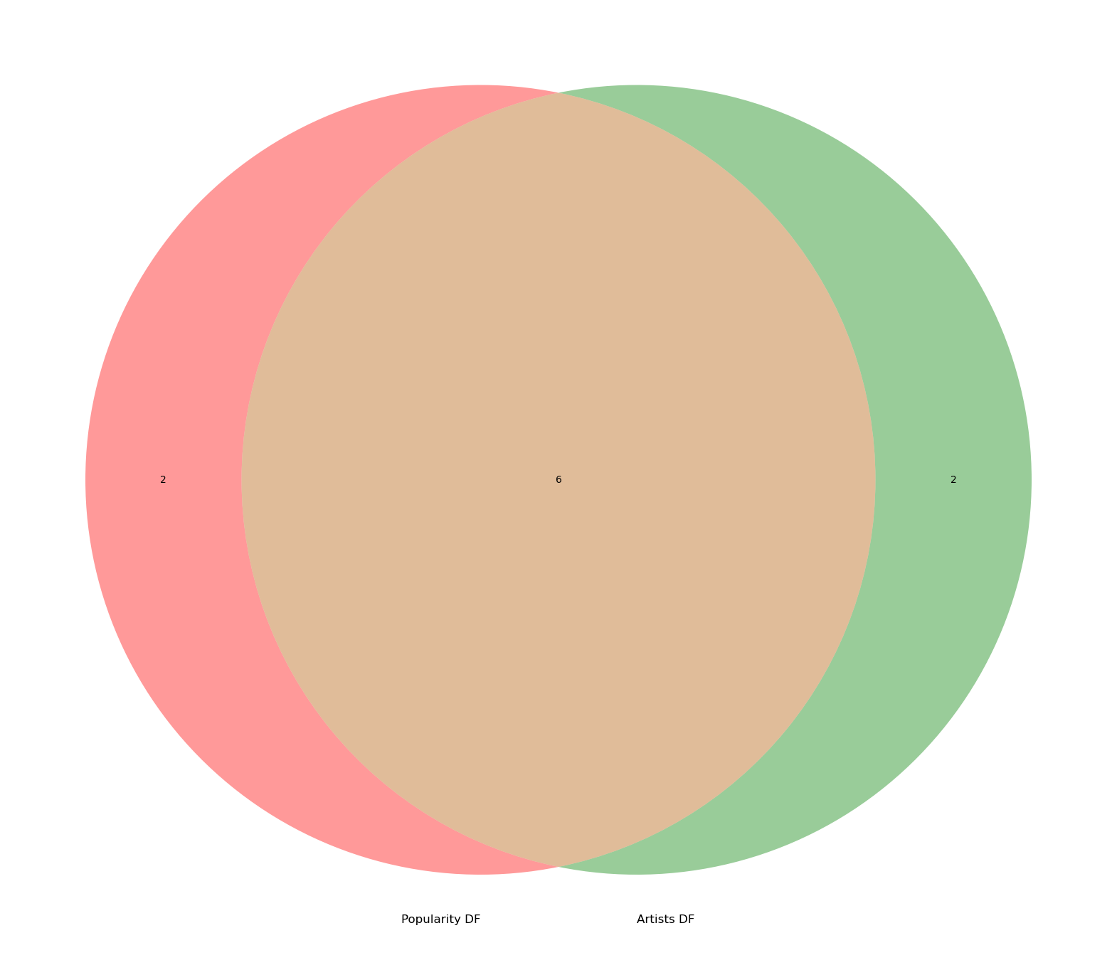
4. Do Popular Artists Make Popular Songs, or Do Popular Songs Make Artists Popular?
We found that popular artist are tend to have more popular tracks.

Slide 11
Sources
SPOTIFY API LINK :
https://developer.spotify.com/documentation/web-api
PLAYLIST OF STUDY:
https://open.spotify.com/playlist/7c2c13pKxvFDSV4WSyydyg?si=99e7d02112994002&nd=1&dlsi=07acf24cee144730

